Slide 1
“Harrison Bergeron” By: Kurt Vonnegut

Slide 2
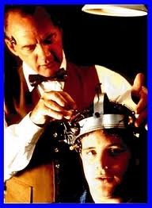
Dystopia
Dystopia: A futuristic, imagined universe in which oppressive societal control and the illusion of a perfect society are maintained through corporate, bureaucratic, technological, moral, or totalitarian control. Dystopias, through an exaggerated worst-case scenario, make a criticism about a current trend, societal norm, or political system.

Slide 3
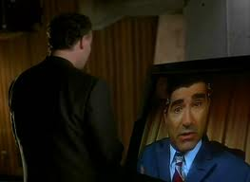
Characteristics
Propaganda is used to control the citizens of society.
• Information, independent thought, and freedom are restricted.
• A figurehead or concept is worshipped by the citizens of the society.
• Citizens are perceived to be under constant surveillance.
• Citizens have a fear of the outside world.
• Citizens live in a dehumanized state.
• The natural world is banished and distrusted.
• Citizens conform to uniform expectations. Individuality and dissent are bad.
• The society is an illusion of a perfect utopian world.

Slide 4
Types of Dystopian Controls
• Corporate control: One or more large corporations control society through products, advertising, and/or the media. Examples include Minority Report and Running Man.
• Bureaucratic control: Society is controlled by a mindless bureaucracy through a tangle of red tape, relentless regulations, and incompetent government officials. Examples in film include Brazil.
• Technological control: Society is controlled by technology—through computers, robots, and/or scientific means. Examples include The Matrix, The Terminator, and I, Robot.
• Philosophical/religious control: Society is controlled by philosophical or religious ideology often enforced through a dictatorship or theocratic government.

Slide 5
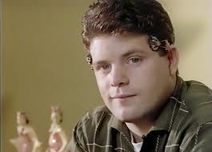
The Dystopian Protagonist
• often feels trapped and is struggling to escape.
• questions the existing social and political systems.
• believes or feels that something is terribly wrong with the society in which he or she lives.
• helps the audience recognize the negative aspects of the dystopian world through his or her perspective.

Slide 6
SATIRE
Satire - the use of humor and wit with a critical attitude, irony, sarcasm, or ridicule for exposing or denouncing the frailties and faults of mankind’s activities and institutions, such as folly, stupidity, or vice. This usually involves both moral judgment and a desire to help improve a custom, belief, or tradition.

Slide 7
Text Info:
‘‘Harrison Bergeron’’ is set in the future, when Constitutional Amendments have made everyone equal. The agents of the Handicapper General (H-G men, an allusion to the practice in the 1940s and 1950s of referring to Federal Bureau of Investigation and Secret Service officers as G-men, the G standing for government) enforce the equality laws.
People are made equal by devices which bring them
down to the normalcy level in the story, which is
actually below-average in intelligence, strength, and
ability.
These devices include weights to stunt speed
and strength; masks, red rubber clown noses, or thick glasses to hide good looks and to make seeing difficult; and radio transmitters implanted in the ears of intelligent people, which emit sharp noises two or three times a minute to prevent sustained thought.
Thematic ideas: equality, freedom, power.
Published October 1961 in a Science-Fiction magazine
Became popular in the 1980’s

Slide 8
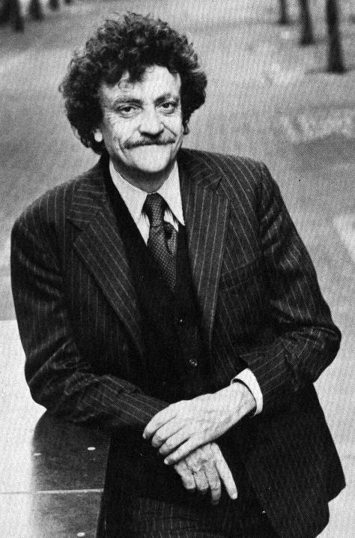
KURT VONNEGUT JR.
Born in Indiana in 1922
Was the editor of his high school newspaper
Joined the Army
WW II
Taken captive
POW
Earned a Purple Heart
Later worked as a police reporter

Slide 9
consternation
A feeling of alarm or confusion caused by something unexpected

Slide 10
cower
To cringe or move backward as if from fear

Slide 11
synchronizing
To make something happen at the same time as another

Slide 12
vigilance
Being watchful or alert , especially to lookout for danger

Slide 13
wince
To make an expression of pain with the face

Slide 14
Setting
Setting the story is the year 208. The future allows readers to more easily accept some of the more absurd events in ‘‘Harrison Bergeron.’’ The actual physical location of the story does not matter and, therefore, is unknown. However, because of the amendments, we assume the United States.

Slide 15
Point of view
Point of View
The story is told in the third-person-limited point of view; the narrator is not a character in the story, but he is privy to the thoughts of one character. Readers are allowed to know what George Bergeron is thinking, as when he "was toying with the vague notion that maybe dancers shouldn't be handicapped.'' The events in "Harrison Bergeron'' are related by an objective narrator. The narrator does not draw conclusions, make decisions, or make judgments about the events. The objectivity of the narrator suggests a distancing from the hostile world of the story.

