Slide 1
Speech
Mrs. Messerole

Slide 2
The Communication Process
Sender-
Message-
Feedback-
Receiver-

Slide 3
Communication Barriers
Attitudinal- Perception, attitude towards a subject/ person/ idea,
Social- social class, economics, customs, manners, behavior
Educational- level of schooling, literacy, general knowledge, background information
Cultural- language barriers, taboos, customs, basic values, stereotypes
Gender- Gender roles in society, stereotypes, power struggle, oppression,
Environmental- noise, space between people, time, climate, choice of medium
Emotional- mistrust, guilt, fear, defensiveness, suspicion, sad, anger
This Photo by Unknown Author is licensed under CC BY-NC-ND

Slide 4
What can the sender do to improve communication?
Think
Articulate
Watch

Slide 5
What can the receiver do to improve communication?
Ask
Learn
Relate

Slide 6
Active vs. Passive Listening
According to the Commission on the English Curriculum, “Listening is the neglected language art at all educational levels.”
Speakers and listeners share the responsibility for good communication.

Slide 7
Passive Listening
As listeners, we tend to think that the responsibility for successful communication lies with the person doing the talking. This attitude (a communication barrier) causes us to become lazy or passive listeners.
We let the talker do all the talking and all the work in the communication process
We fail to respond to the message
We usually did not hear the entire message
Focused on other things, like how the person looks
Tolerate or focus on distractions

Slide 8
Active Listening
Opposite of passive listening is active or effective listening. Active listeners guide the talk toward common interests
Fortune magazine rates listening as the top management skill needed for success in business.
Active listening is important in maintaining healthy relationships
Strong listening skills help students in school

Slide 9
Greek Philosopher Epictetus
“Nature has given us one tongue, but two ears. So that we may hear twice as much as we speak.”

Slide 10
Interviewing
An interview is a conversation controlled but not dominated by one person who asks question of another person.
An interview is a conversation with a purpose.

Slide 11
Interview Speech
Do not think of interviewing as Ping-Pong
Instead interviewing is like a handshake
Trust
Mutual understanding
Mutual respect

Slide 12
Choose When and Where
The best setting for an interview is a place where you will not be disturbed
Take your parents out of the home (less distractions)
Try to get the person away from their desk
If you are unfamiliar with the person your interviewing, please pick a safe public location.
Due Thursday: Who is being nterviewed and a location and time of when the interview will take place.

Slide 13
Consider your Audience
A professional interviewer acts as a proxy for the audience.
As a interviewer it is your task to keep the interests of your potential audience in mind.
What topics would interest my audience
What can they learn from the interviewer
Is there background information I need to discuss, so my audience has a clear understanding of what the full details are
https://www.npr.org/programs/fresh-air/2018/04/10/601122993/fresh-air-for-april-10-2018-a-devastating-fall-couldnt-keep-this-rodeo-rider-off

Slide 14
Be Curious
You need to have curiosity
Why?
You gather information people want to hear
Everyone has something interesting to say, it is your job to be curious enough to find that story
Curiosity helps succumb self-consciousness and can drive nervousness away
People like to talk, so if you mention that you are interested, people will talk
Lack of curiosity can lead to lazy thinking and lazy questions.
https://www.cbsnews.com/news/911-tower-of-voices-wind-chimes-flight-93-memorial-shanksville-pennsylvania/

Slide 15
At the start of an Interview
Dress for success
Make sure you have everything you need to record the interview
Restate why you are interviewing them
Ensure they know they are being interviewed for a speech class and that their story will be retold (objectively) by you
Ensure that interviewee is on tape explaining that they are okay with being recorded while conducting the interview
Have your questions ready to be used

Slide 16
What is the difference between a simple question and a foolish one?

Slide 17
Asking effective questions
Make sure questions are to the point
Avoid two- or three-part questions… Why?
Use a variety of questions (who, what, when, where, and how)
Use open ended questions
Use follow-up questions
Follow-up questions are for when you hear an intriguing statement and your want to expand on this statement
You must be able to think on your feet
This Photo by Unknown Author is licensed under CC BY-SA

Slide 18
Questions to Avoid
Yes-no questions (why?)
Leading questions
They influence answers
For example, “Was the UFO shaped like a saucer or a cigar?”
This Photo by Unknown Author is licensed under CC BY

Slide 19
Change these yes-no questions to be open-ended.
“Did you enjoy working on the television show?”
“Where you frightened when the authorities came?”
“Will you live in California again?”
“Is your daughter speaking to you now?”

Slide 20
The most important thing you can do during your interview?
Listen
I know its obvious!
But it is important

Slide 21
Getting off on the right foot
Remind the interviewee who you are
Why you are there
And what you plan to do with their interview

Slide 22
Beginning of the Interview
The first part of your interview can include a routine “get-acquainted” questions
How are you doing?
Are you having a good day
These questions can get the ball rolling
Be enthusiastic but do not be phony

Slide 23
Getting into the flow of questioning
Each question should flow together
Pay attention
Use follow up question
Think on your feet
It is okay to pause and think about what you want to ask

Slide 24
Use eye contact
It is important to look at the person in the eye
Participate in the interview by being an active listener
Treat the interviewee how you would want to be treated
With Respect and general curiosity

Slide 25
Be Persistent
What happens when you ask a question and the interviewee does not answer?
If you are a good listener you will notice that sometimes when an interviewee speak it does not always cover answer your question
So…Do not be afraid to ask a question twice (only if they did not answer it)
Try to rephrase the question
Be okay with silence, this gives space for your interviewee to speak
Be patient, if you subject is thinking about an event from a long time ago be patient with them.
Why?

Slide 26
Final Question
Is there anything else you would like to tell me?

Slide 27
After the Interview
Thank your interviewee in person or by sending them a formal thank you card
Make sure you write notes that you missed immediately after the interview. If you wait too long after the interview to recall information from the interview, you risk misrepresenting the conversation and story.

Slide 28
Instant impact When you meet someone with a disability
Visually impaired
Speech impediment
Wheelchair
Hearing loss
http://www.spinal-injury.net/meeting-a-disabled-person.htm

Slide 29
“We do have a strange tendency in this country to equate any kind of disability with less intellectual capability and with even a less complete humanity. Certainly as a child and as a teenager — and even now as an adult — [I] encountered people who assumed that just because I used a wheelchair, maybe I couldn't even speak to them. I often get questions directed at people I'm with, as opposed to me, and that's a really interesting phenomenon” –molly Brown

Slide 30
Are you Listening to me?
Topic: What sport is the best? (easy)
Topic: Should students and staff be allowed to practice religion in public schools. (hard)
Game Rules
One person will begin the conversation by stating their opinion. Make your statements crisp and to the point.
I will select another person to respond.
Each speaker must restate the previous speaker’s point (not word for word) before giving their own opinion.
If you do not follow rules, you are out of the game. If you repeat an opinion you are out of the game.
Example: I acknowledge your point about veggies being healthier than pepperoni; However, I believe that most calories in a pizza is from the crust, and I believe this calorie in take of crust and cheese makes each pizza equal in nutritional value.

Slide 31
Chapter 1:3
Stereotypes
Stereotyping means labeling every person in a group based on a preconceived idea as to what that group represents.

Slide 32
Nonverbal communication
Nonverbal communication expresses your attitudes or moods about a person, situation, or your ideas
Nonverbal communication varies and can be interpreted differently throughout the world, depending on social and cultural norms.

Slide 33
Symbols
Symbols-

Slide 34
Quick Write take out your notebooks
Have you ever used words to hurt another person?
Maybe you wanted them to feel sad, so you told them how awful they are.
Have you ever used words to make someone else feel better?
Maybe you wanted someone to feel happy, so you told them how awesome they are.
Write about both experiences.

Slide 35
Chapter 1 Section 2
Please read this section and take notes.

Slide 36
Laying the Proper Foundation
Name a prominent speaker who has used their words to advance humankind.
Name a prominent speaker who has used their words to harm humankind.
Are there similarities between the two?

Slide 37
Intrapersonal Communication
Inner dialogue with yourself.
https://www.youtube.com/watch?v=by7E5qKxepE
Watch the video and take notes.

Slide 38
2nd Period Partners
Josie, Kelton Chad, Noah
Bridgette, Bayley Colton, Thane
Kaylee, Kendra Tanner, Mallory
Trace, Tatum Hayley, Kalub
Chad, Thane Lydia, Ellie

Slide 39
Self Perspective establishing an accurate perception Chapter 2 Section 2

Slide 40
Perception
Perception is how you see things.
An accurate perception is a tool that helps us learn more about ourselves, our objectives, and about other people
But a inaccurate perception can do what…

Slide 41
An inaccurate perception can BLOW things out of proportion!

Slide 42
How to build confidence
What are some of your fears about public speaking?

Slide 43
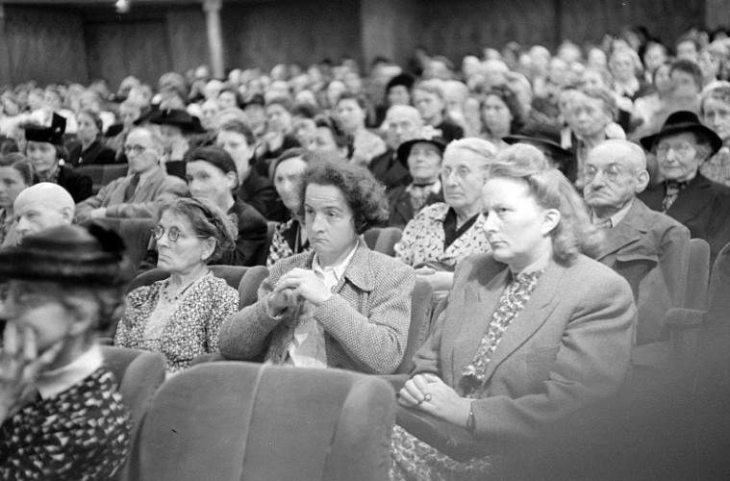
Perception of the Audience
People think that giving a speech a big deal… and it is!
But it not life or death
Studies show that your audience will most likely not pick up on your nervousness
Remember that your audience wants you succeed, not fail… so they will forgive you if you make a mistake.
Remember, we are our most critical judges, so how you feel is most likely not an accurate reflection of how you audience feels.

Slide 44
Perception of the Speech
You should see speaking as an opportunity to share something you consider valuable
Speeches are just a chance for you to share information
Do not fall into the idea that this needs to be a show
Do not fall into the idea that you will give the best speech Hot Springs High School has ever seen (those are unrealistic expectations)
Be aware of how powerful words can be and have a clear vision and understanding how the message you are sending you audience

Slide 45
Perception of Self
We are hyper critical of ourselves and often have a hard time accepting who we are
Change that voice in your head… to sound more positive
Example, instead of thinking that you are different or inadequate change that voice to remind yourself that you are a work in progress and that you are unique
Failure is not the end. Failure is an opportunity for innovation and improvement

Slide 46
Confidence (Self-Esteem)
Is not something you are born with
You must learn to think and feel confident
Rate how confident you are
1,2,3,4,5,6,7,8,9,10

Slide 47
Planks of Confidence Chapter 2 Section 3
Content
Organization
Notes
Friendliness
Impression
Dedication
Empathy
Conviction
Enthusiasm

